Slide 1

Data Visualization Project for Black Friday Sales
Hemanth Kumar Kottapalli
Srinivasa Hrishikesh Madiraju
Asifali Mohammed

Slide 2
Introduction
Every year, the Friday after thanksgiving ignites a global shopping frenzy known as black Friday. This retail deal day, born in the US, has excited customers worldwide with its promise of deals and offers. It’s the official launch of the holiday shopping season, where stores unleash their most tempting discounts, bargain hunters into savings on the products. But Black Friday evolved into a digital bonanza, with online stores offering virtual shopping. This shift has made deals more accessible, but it's also brought new challenges and opportunities for everyone involved.
In this presentation, we will explore the Black Friday sales trends using Tableau data visualization to uncover valuable insights that can empower businesses. We will delve into the impact of various factors on sales and identify key patterns and trends.

Slide 3
Understanding Data Set, Data Source, identify key metrics
Data Source
Kaggle is the source of the data and it contains variables like customer demographics such as city type, gender, age, martial status, stay in the current city, product details, categories, and purchase amount.
Data Understanding
Identify Key Metrics
Define the key metrics for analysis may include total sales revenue, average purchase value and product specific performance
Examine the data variables like product categories, purchase amounts, and customer demographics

Slide 4
Research Questions
Unveiling Consumer Behaviour
1
Identifying Sales Trends
2
Improving Market Strategies
3

Slide 5

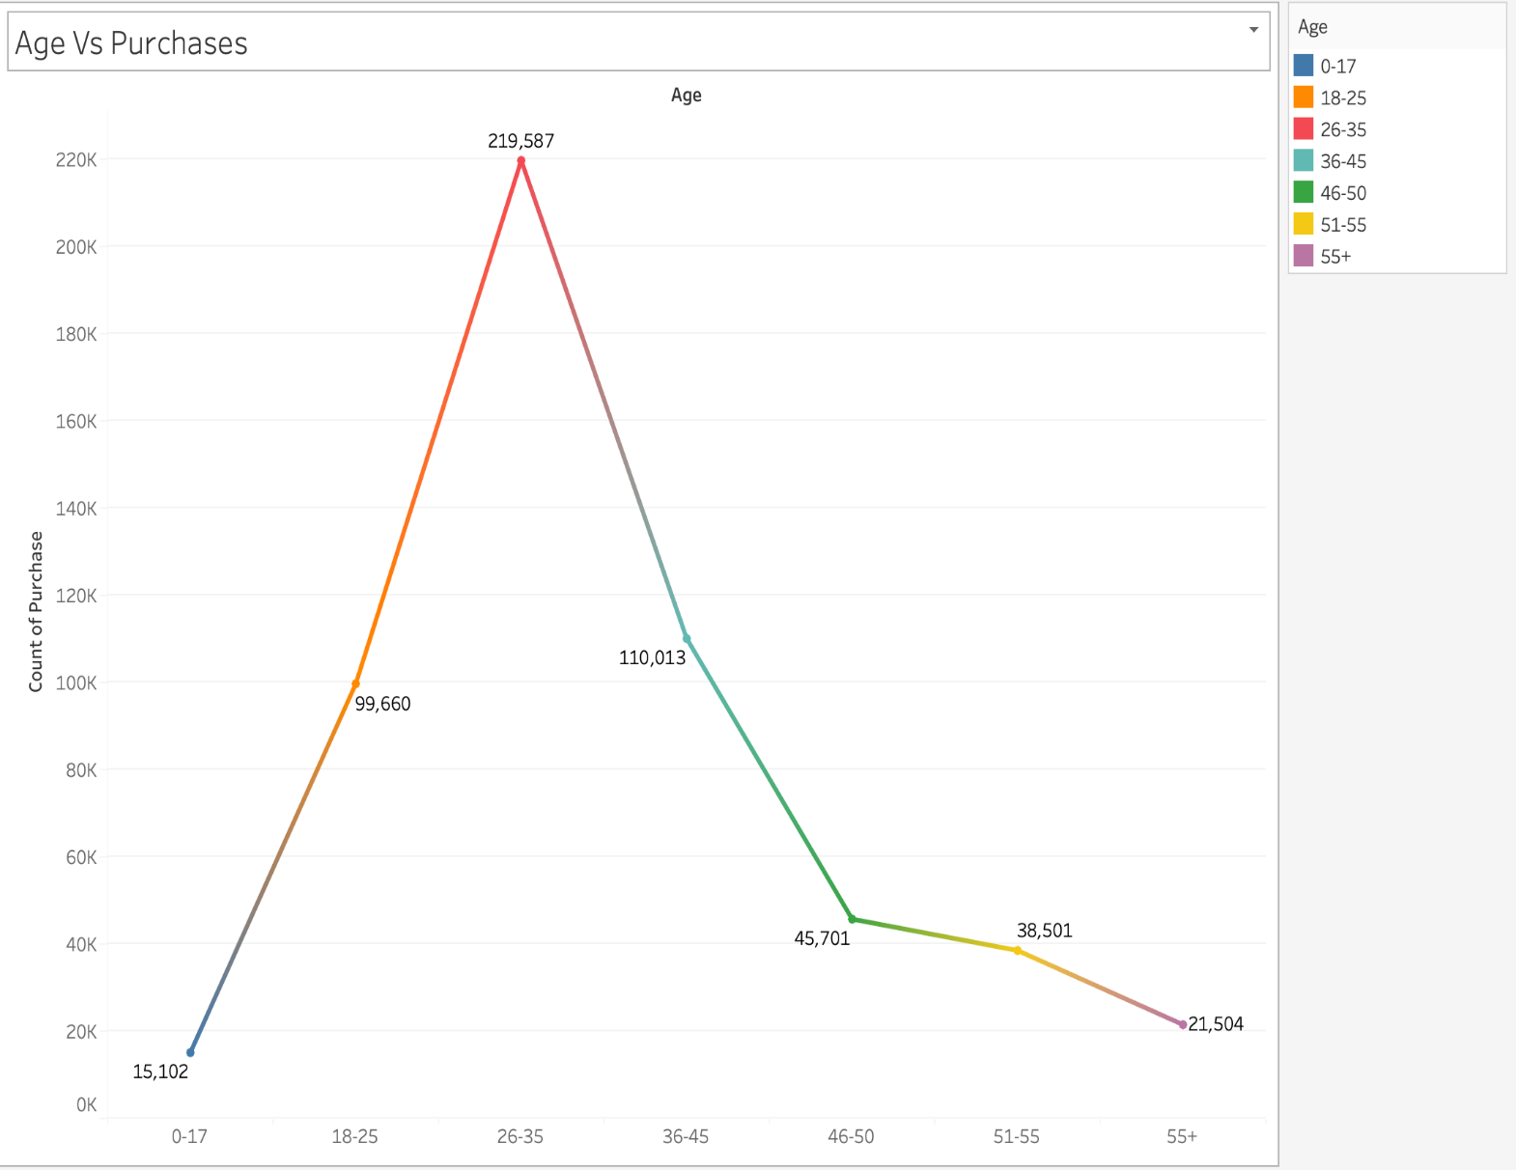
Age Vs Purchases
The data shown in the Line-graph explains that people between the ages of 25-35 buy more during Black Friday sales than any other age group and the second age group which buy more are in the age demographic of 35-45.
This means that the majority of Black Friday sales come from individuals in the 25-35 age range.
This approach helps retailers concentrate on promoting products that sell well within two specific age groups for more sales.

Slide 6
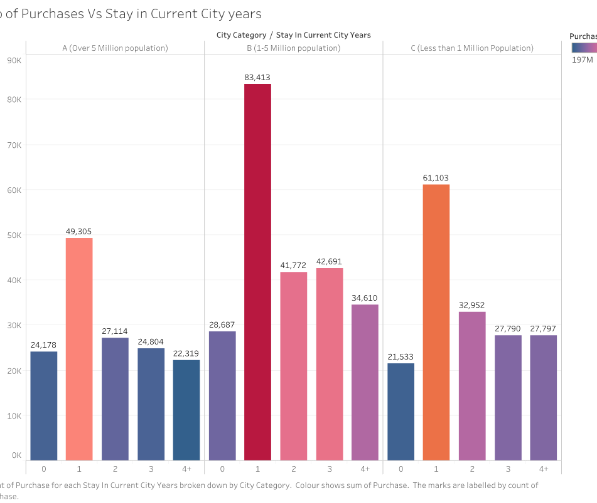
Stay in current city Years
The Bar-graph was split into three groups: A, B, and C. It clearly indicates that people in group B, who have lived in the city for one year, make more purchases compared to other city residents on Black Friday.
With this analysis it helps the businesses to focus on the certain residents for more accurate sales.

Slide 7
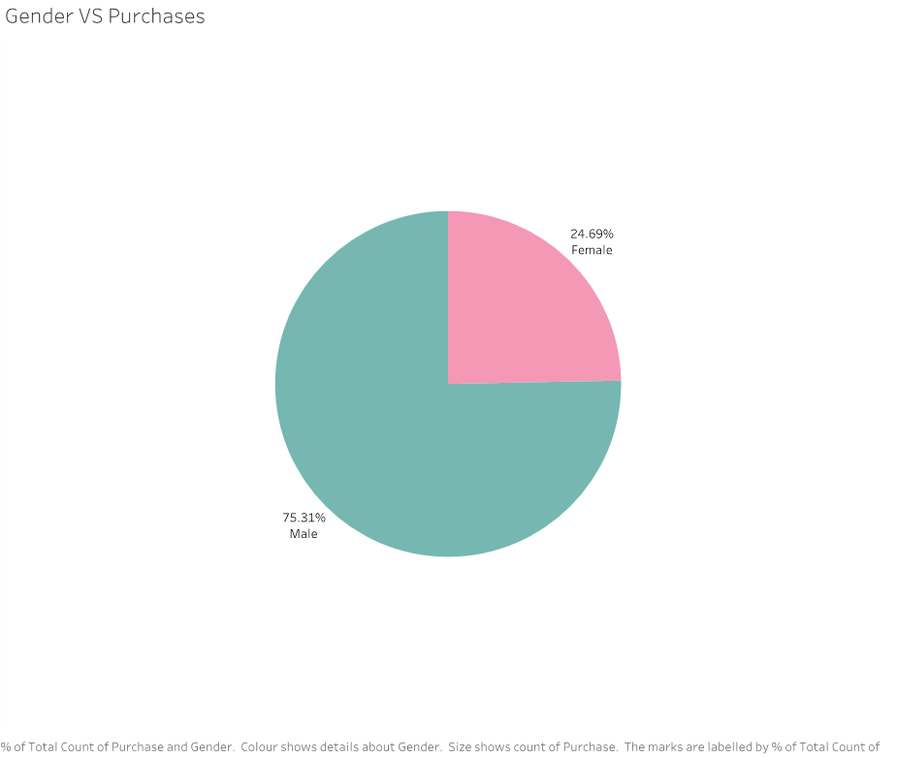
Gender Vs Purchases
Looking at the pie chart representing purchases based on gender, it's evident that men make more Black Friday sales transactions than women.
With the help of this pie chart , retailers can promote the products which are used by female consumers to increase the sales from them and maintain consistency for the male consumers as they buy more on Black Friday sales.

Slide 8
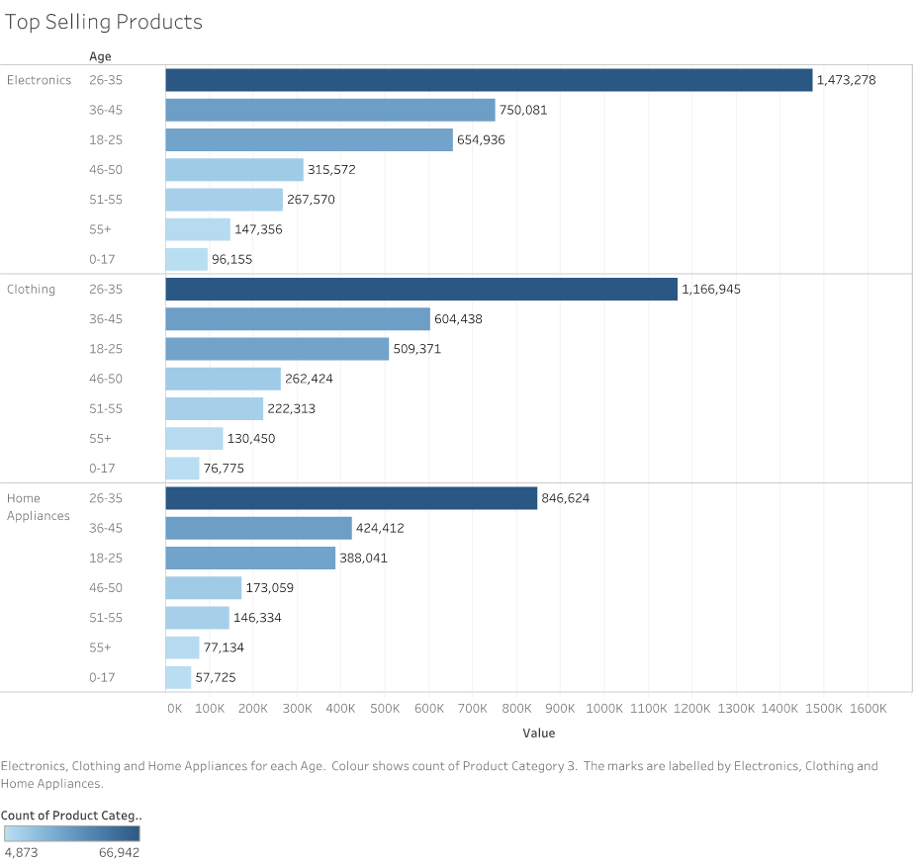
Top selling Products
The stacked bar graph shows that electronics had the highest sales on Black Friday, followed by clothing.
This information is valuable for retailers because it suggests they should focus more on promoting and featuring these products. Additionally, for online retail algorithms, it indicates they should prioritize recommending and showcasing these items on websites

Slide 9
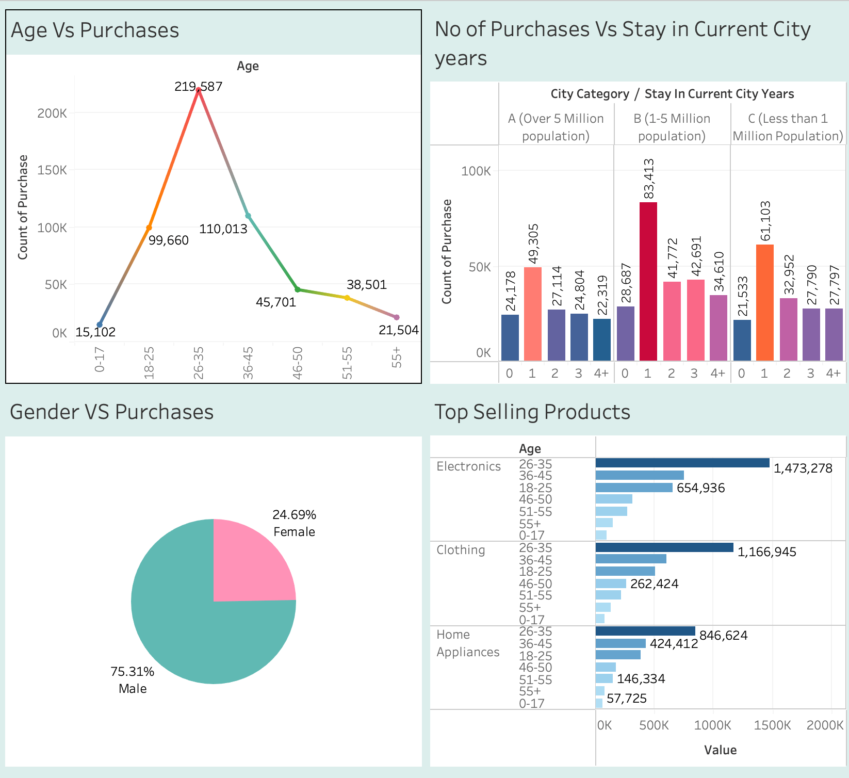
DASHBOARD
Visualizing sales data across product categories, Age, gender and Current city years our dashboard empowers decision-makers with actionable insights to optimize marketing strategies, inventory management, and overall business performance.

Slide 10
Conclusion
Our visual analytics uncovered valuable insights into Black Friday spending:
25–35-year-old customers are key – they outspend other age groups.
Customers who moved to city in the past 12 months tend to spend more during Black Friday sales.
Men make more overall purchases than women.
Unmarried customers tend to spend more than married people.
Consumers spend more in electronic categories followed by clothing and home appliances.

Slide 11
Recommendations from Analysis
Retailers can apply these learnings to fine-tune promotions:
Targeted ads for the high-spending groups like 25-35 years old.
Offer special deals on electronic gadgets like TV's, laptops for those who moved recently to new city.
Men tend to buy more during Black Friday sales with proven demand, spotlight electronic gadget deals and feature tools.
The data showing that City Category B customers tend to spends more on Black Friday provides a clear target segment for retailers.
Data-driven strategies will empower businesses to optimize Black Friday returns.
Also promoting unmarried consumers encourages to buy more products.

